Slide 1
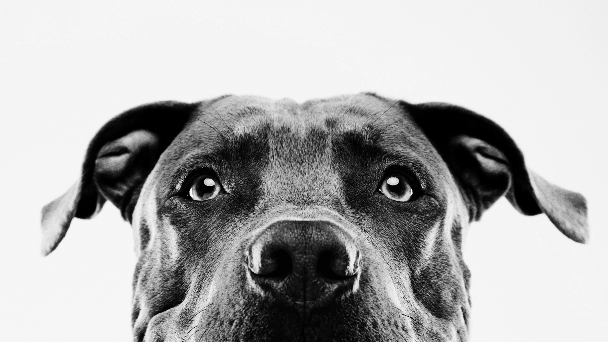

Technical assessment
Valentino ong

Slide 2
Quick Recap
Problem: PetFinder.my has faced falling donations and slower adoption rates and with adoption rate as one of the key metrics for the organization, they need a way to predict this key metric to understand factors affecting adoption rate
Data: Pet listings from PetFinder.my portal
Objective: Use the data to extract features to predict adoption rate and better understand the adopter’s preference
Consideration: Ethical implications of the model need to be considered
Benefits of good prediction model:
Fresh new content for the portal
Boost revenue from sponsorship and partnership
Most importantly, animals are able find a new home sooner
Notes:
So first I will do a quick recap, so the problem was that petfinder Malaysia has faced falling donations and slower adoption rates and with adoption rate as one of the key metrics for the organization, they need a way to predict this key metric to understand factors affecting adoption rate. The data given was from pet listings in their portal and the objective is to use the data to extract features to predict adoption rate and better understand the adopters preference. So if we were able to get a good prediction model, the benefits are that there will be fresh new content for the portal, boost revenue from sponsorship and partnership and most importantly, animals are able to find a new home sooner

Slide 3
Data at hand
Categorical
Numerical
Not used/dropped
AdoptionSpeed State
Type BreedPure
Breed1 NameorNo
Breed2
Gender
Color1
Color2
Color3
MaturitySize
FurLength
Vaccinated
Dewormed
Sterilized
Health
Age
Fee
Video Amount
Photo Amount
Quantity
ColorAmt
PetID
Name
AgeBins
FeeBins
BreedBins
Many more…
Pets_prepared.csv:
14,993 rows of data
49 Features
Unstructured/created data
Description
DescriptionCleaned
Tf-ids
DescriptionLength
DescriptionWordCount
Color Code:
Red: Created by me
Notes:
The data at hand was from pets_prepared.csv with a total of 14,993 rows of data and 49 features. These are all the different categorical, numerical, not used or dropped and other data that I worked with with the red color features being created by me

Slide 4

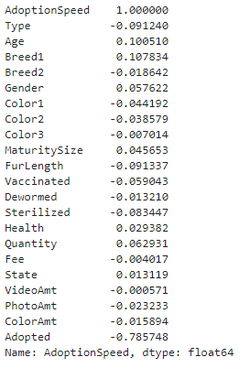
1st step of my Eda
Check for missing values
Check for Collinearity
Check for obvious relationship between the dependent variable and the target variable
3 ways to deal with it:
Drop the rows
Drop the columns
Fill in missing values
Notes:
Moving onto the EDA, the 1st step I did was to check for missing values, I found that the name, description and Breed name are missing values and there are 3 ways that I usually deal with it, first being drop the rows, secondly drop the columns then lastly filling in the missing values. Next I also check for collinearity to see if there is an obvious relationship between the dependent variable and target variable.

Slide 5
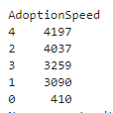
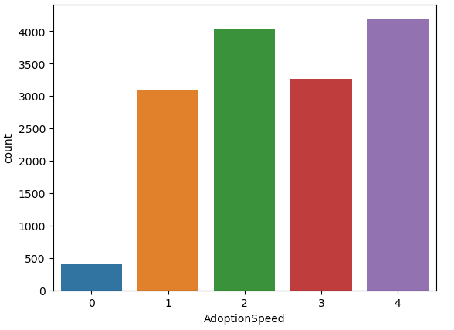
Check the Target variable (adoption speed)
AdoptionSpeed count:
Most animals are adopted at adoption speed of 4 followed by 2
Unfortunately, least animals are adopted at adoption speed of 0 which is same day the animal was listed
Notes:
Before actually dealing with the missing values, I did a check on the predicted variable which is adoption speed. So I first did a value count to see the count across the different speed and also create a visualization, we can see that most animals are adopted at adoption speed of 4 followed by 2 and least animals are adopted at speed of 0 which is the same day the animal was listed.

Slide 6
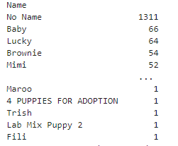
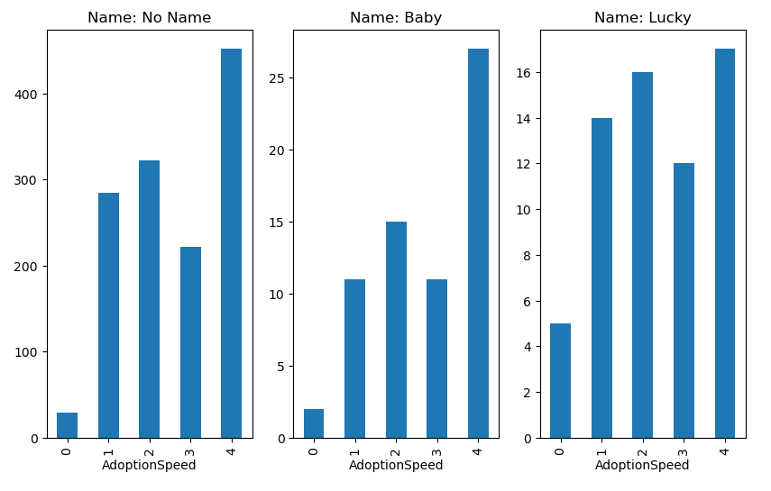
Variable: Name
8 missing values
Most do not even have name to begin with (same as null essentially)
Some names are not even names but description
9059 unique names
In general, follows the same relationship
Need to encode 9059 names, might not be worth it
Drop the column!
Notes:
Now returning back to the variable with missing values which is name, there are 8 missing values. After doing a value count, we can see that most don’t even have a name to begin with and some names are not even names but descriptions. There are also a total of 9059 unique names and after creating a visualization of the adoption speed count for each name, in general most of the name follows the same relationship. Furthermore, if we want to use it for training, we need to encode 9059 names which might not be worth it as it can be too computationally expensive. So I decide to drop the column

Slide 7
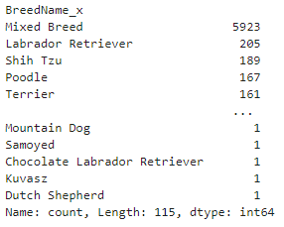
Variable: Breedname
5 missing values
Identical to column Breed1 except Breed1 is encoded
BreedName is just unencoded Breed1
There is no use for this aside for easier visualization title
Drop the column!
Notes:
Next is Breed Name, there are 5 missing values and it is actually identical to column Breed1 except that Breed name is just the unencoded version of Breed1. So there is no use for this aside for easier visualization title and we can just simply drop the column. I will cover the description column later on as it is a much more complex feature.

Slide 8
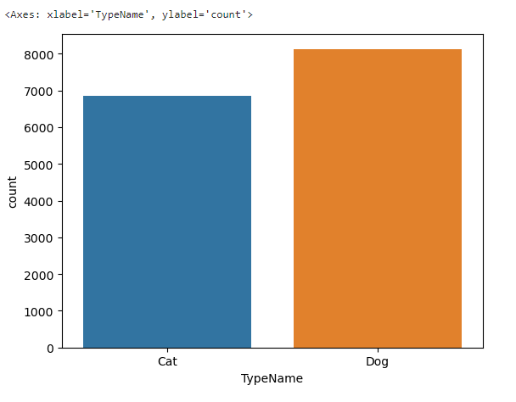
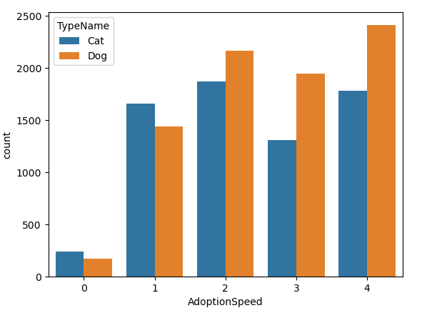
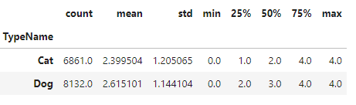
Categorical variables
EDA I performed on categorical variables are generally the same
Create visualization (E.g. Bar chart) across the different categories
Get descriptive statistics of each categories like mean etc
Before training, some are encoded using LabelEncoder like NameorNo, BreedPure etc
Example: Animal Type
Bar Chart
Descriptive Statistics
Notes:
Instead I will go through the EDA on the different data types first. First one is categorical variables, so the EDA I performed on categorical variables are generally the same. I will create a visualization using bar chart across the different categories and then get descriptive statistics of each categories such as mean, median using the pandas function describe. Before training, for some of the features that are not already encoded, I will perform a label encoding to the features such as NameorNo and BreedPure. An example of the EDA I did was for feature animal type, I created 2 bar charts, from the left side, we can see that there are more dogs than cats in the adoption center, from the middle bar chart, from the pattern itself we can see that more cats are adopted at a lower adoption Speed as compared to the dogs as more percentage of the cats falls under lower adoption speed and even the descriptive statstic supports this as the mean adoption speed for cat is lower than that of dog.

Slide 9
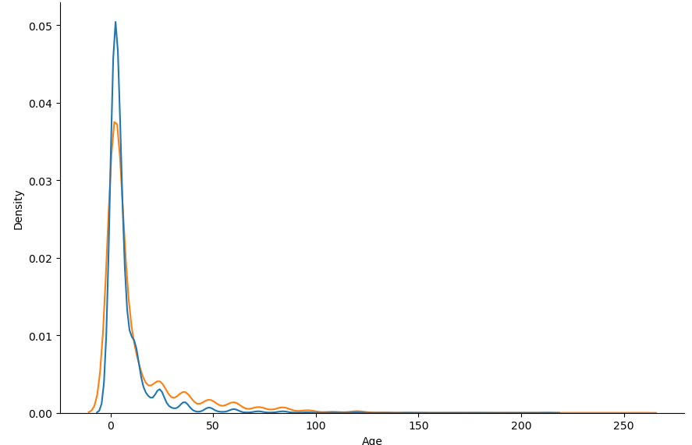
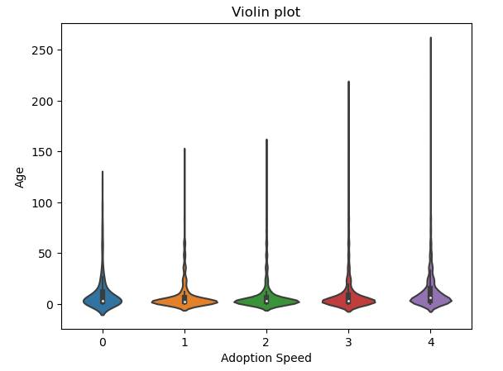
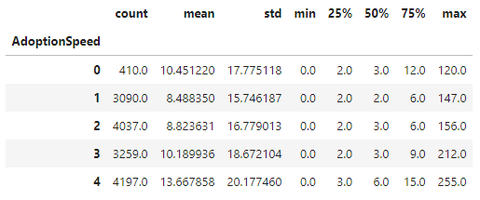

Numerical variables
EDA I performed on numerical variables are generally the same
Create visualization (E.g. histogram/KDE plot, violin/box plot) to show the distribution of the numbers
Get descriptive statistics of the numerical variables by using group_by on AdoptionSpeed
Example: Age
KDE plot
Violin plot
Descriptive Statistics
Notes:
For the numerical variables, similarly again, the Eda I performed are generally also the same. I create visualisations using histogram, KDE, violin or box plot to show the distribution of the numbers and then get the descriptive statstics of the numerical variables by using the group by on adoption speed instead. So for example age, I did a KDE plot and a violin plot, from the KDE plot, we can see that most of the animals are actually young regardless of dogs or cats, and from the violin plot, the width of the violin at the median is also larger for adoption speed 1 and 2 indicating more animals are younger for adoption speed 1 and 2 as compared to the rest. I also did a descriptive statistics and it also supports the pattern of younger animals tend to get adopted faster as the mean age increases as adoption speed increases

Slide 10
Not used/dropped data
Some are just unencoded version of features like BreedName vs Breed1
Some features are binned version of other features like VideoAmtBins vs VideoAmount
- Binning might result in under representation of certain values
- Loses information (Not so ethical)
Ultimately Dependent if using the binned data will allow the model to perform better
In my case, none of the models with the binned data perform better than using the actual data so did not use the binned version
Notes:
Moving onto data that are not used or dropped, the reasons they are so are because some of them are just unencoded version of other features like Breed name and breed 1. Some features are also binned version of other features like Video Amount and video amount bins. Binning can be good as it can make the data more simpler to understand, reduce complexity and good for data that have many outliers or are skewed. But it can also result in under representation of certain values and can result in losing of information which can go against the consideration of ethicality. Ultimately, binning of data is dependent if the model will perform better. In my case however, none of my models performed better using the binned data and so I decide to use the actual data itself.

Slide 11
Description
13 Missing values
Did not drop the column/rows as it improves the model performance
Produce DescriptionLength and DescriptionWordCount
Steps to produce DescriptionCleaned:
1) Convert to small letters
2) Clean punctuation
3) Keep alpha
4) Remove stopwords
5) Stemming
6) Fill NaN for empty ones
Create a tf-idf matrix out of the top 1000 frequently appeared words
Notes:
Going back to description which is a much more complex data, there are 13 missing values. I decide to not fully drop the column or rows as the features that I produced from it improves my model performance. So from description, I was able to produce description length and description word count but I believe this is not sufficient to capture the whole meaning of the description. Hence I decide to produce a cleaned version of description by converting it to small letters, cleaning the punctuations, keeping the alpha, removing the stop words, stemming to get the base form of the words and then filling the empty ones with an empty string. Finally, I created a tf-idf matrix our of the top 1000 most frequently appeared words.

Slide 12

Model evaluation (base model)
Train test split
 | Random Forest | Gradient Boosting | AdaBoost | SVM | XGB Classifier | Gaussian Naïve Bayes
Accuracy | 0.42 | 0.41 | 0.39 | 0.27 | 0.40 | 0.34
F1 Score (Avg among 5 classes) | 0.354 | 0.31 | 0.294 | 0.086 | 0.32 | 0.268
Random Forest best baseline model
Notes:
Before I train the model, I did a train test split of 20% testing and 80% training. I then did a model evaluation base of the base model of different classification algorithms. So from the table, I evaluated the accuracy and average f1 score of random forest, gradient boosting, Ada boost, SVM, XGB classifier and Gaussian Naïve bayes model. From here, I concluded that the random forest model performs the best among the rest and decided to proceed with random forest model.

Slide 13
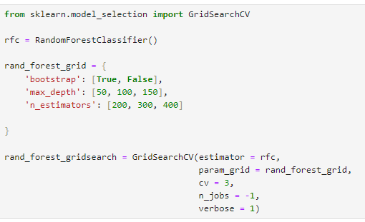
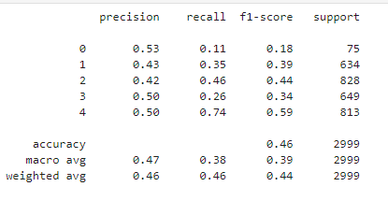

Proceeding with random forest model
Utilize GridSearchCV: To find the best hyperparameters to be used for the model to get highest accuracy and f1 score
Eliminate the need to manually create a validation set due to k-fold cross validation
Final result
Avg F1 score: 0.388
Notes:
Proceeding with the random forest model, I used grid search cv to find the best hyper parameters to be used for the model to get the highest accuracy and f1 score, grid search cv also eliminates the need to manually create a validation set due to k fold cross validation. So from the model that grid search have me, it was able to achieve an accuracy of 0.46 and average f1 score of 0.388.

Slide 14

Flow of pipeline
Dataprep.py
X_train.csv
Y_train.csv
Data preprocessing
Data Retrieval
Train-test split
Feature engineering
(Tf-idf creation, encoding etc)
X_test.csv
Y_test.csv
CSV file
Data preparation
Evaluation
GridSearchCV
(try all combination)
Classification report produced
(END)
Best result model produced
Fit
Model.py
Notes:
Lets look at the flow of the pipeline, so first we will retrieve the data from the csv file. In dataprep.py, Data preprocessing occurs where I choose the data that I want to include in the training, feature engineering where I created additional features and then did a train test split and store them into their respective csv files. This csv files is then used by model.py where in model.py, there is a grid search cv that try all the different hyper parameters combination using a random forest model, and when the best model is produced, it is saved in the proper folder and then evaluated against the test set to produce a classification report containing precision, recall, f1 score and accuracy.

Slide 15

End. thank you so much!

